Slide 1
Detailed work plan of WIS team under the Package C PAMP II Action plan for Package C
Azamat Karypov, International Consultant on WIS
E-mail: azamatik2007@yahoo.com
Rauf Yuldashev, Local Coordinator of WIS
E-mail: raufyuldashev@gmail.com
22 December 2017
Dushanbe, Republic of Tajikistan

Slide 2
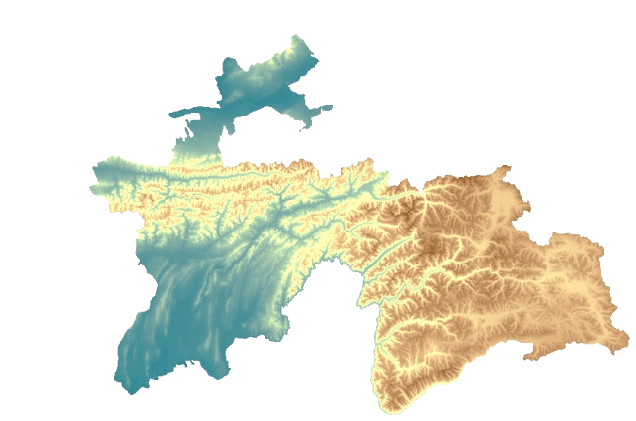
Content of presentation
Objectives and specific targets of Package C PAMP II
Vision of WIS and DIN
Detailed work plan for WIS team
Formation of WIS team
Procurement of office equipment

Slide 3
Objectives and specific targets of Package С
WRIC/MEWR and ALRI in Dushanbe and RBO, sub-RBO and irrigation system management offices in Kofarnihon River Basin (KRB) equipped with recommended computer hardware and software, and WIS staff.
A local area network (LAN) that links the servers to computers in the WRIC/MEWR and IMIS/ALRI in Dushanbe, RBO and sub-RBO offices and irrigation system management offices in KRB.
A DIN that links WRIC/MEWR with RBOs, IMIS/ALRI and irrigation system management offices via VPN.
Two basin applications, BPD and BWAD populated with basin planning and water balance data from the KRB, respectively and assessable via the WIS DIN.

Slide 4
Objectives and specific targets of Package С
IMIS with irrigation data from the KRB and assessable via WIS DIN and/or the ALRI web portal.
The national geospatial database with multiple spatial layers and assessable via the MEWR LAN, WIS DIN and WRIC/MEWR Website.
A WRIC website to share WIS development news, water resources and irrigation information with stakeholders and unrestricted information with the public. At this stage, all information on the website will come from MEWR and ALRI in Dushanbe and RBO and irrigation system management offices in KRB, not from other stakeholders.

Slide 5
Vision of WIS
ВОДНЫЙ КАДАСТР
ВОДНЫЙ АТЛАС РТ
DB
Firewall Firewall
КООС
МЭВР
АМИ
DB
Центральная база данных ИЦВР/МЭВР
ГИДРОМЕТ
Web Portal
АМИ Кафарниган
DB
ГУП «ХМК»
DB
БОРК
Барки Точик

Slide 6
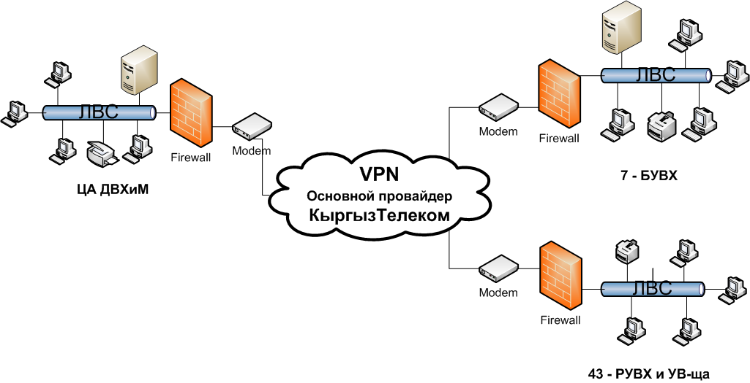
Digital Information Network (DIN)
Vision of DIN
ALRI
WRIC/MEWR
MAIN PROVIDER
DIN link all offices of MEWR and ALRI with WRIC/MEWR via VPN technology
ALRI in Kafornigan и BWO

Slide 7
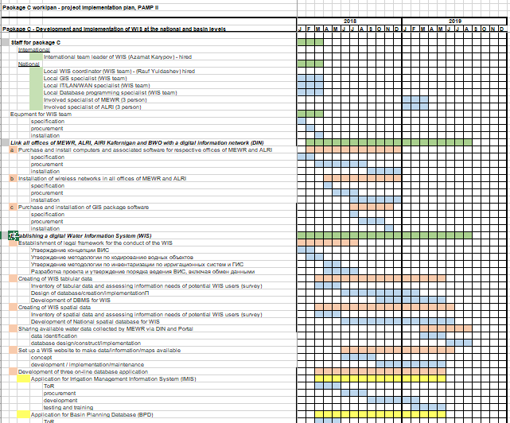
Detailed work plan of Package C

Slide 8
Detailed work plan of Package C

Slide 9
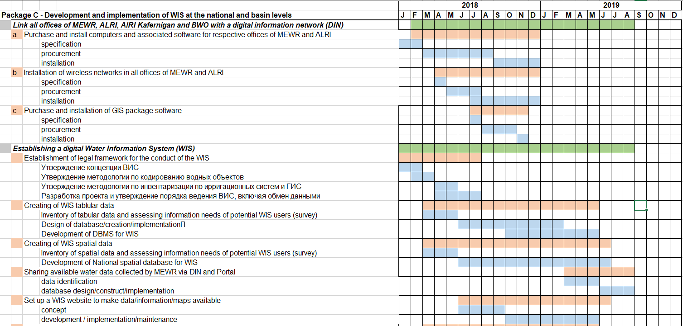
Detailed work plan of Package C

Slide 10
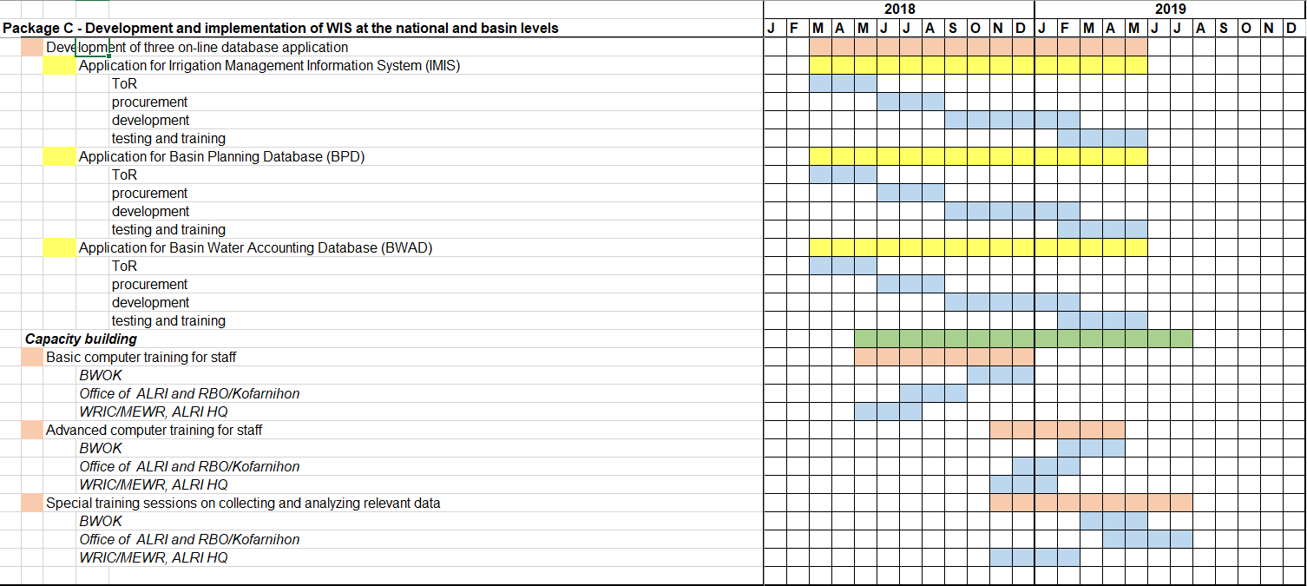
Detailed work plan of Package C

Slide 11
Staff for package C
Indicator 1: International and national specialists on WIS
Deadline: March 2018
Responsible: Procurement unit of PMU, WIS Coordinator
Status: According to target ☑.
Action:
Hiring Intern. consultant on WIS – (Azamat Karypov) on board ☑, starting to work- process , and result ☒.
Hiring National experts:
Local WIS Coordinator - (Rauf Yuldashev) on board ☑, starting to work- process , and result ☒.
Local specialist on DB – ToR ☑, Tender ☒, and on board ☒.
Local specialist on GIS – ToR ☑, Tender ☒, and on board ☒.
Local specialist on IT/LAN/WAN – ToR ☑, Tender ☒, and on board ☒.

Slide 12
Equipment for WIS team
Indicator 2: Equipping the WIS team
Deadline: March 2018
Responsible: Procurement unit of PMU, WIS Coordinator, IT/LAN/WAN specialist
Status: According to target ☑.
Action:
Purchase and installation of computer & software for the WIS team- Specification ☑, Tender ☒, and Installation ☒.
High-speed Internet connections - requirements and analysis ☑, purchase of services– ☒, connection and settings ☒.
Installation of networks (LAN and VPN) for the WIS team– Specification ☑, Tender ☒, and Installation ☒.

Slide 13
Link all offices of MEWR, ALRI, AlRI Kafernigan and BWO with a digital information network (DIN)
Indicator 3: Purchase and install computers and associated software for respective offices of MEWR and ALRI
Deadline: December 2018
Responsible: Procurement unit of PMU, WIS Coordinator, IT/LAN/WAN specialist
Status: According to target ☑.
Action:
Technical specification for the server ☑, tender ☒, and installation ☒.
Technical condition for server repair - in process , tender ☒, repair and equipment ☒.

Slide 14
Link all offices of MEWR, ALRI, ALRI Kafernigan and BWO with a digital information network (DIN)
Indicator 4: Servers with the appropriate server software are installed and operate at the MEWR and ALRI
Deadline: December 2018
Responsible: Procurement unit of PMU, WIS Coordinator, IT/LAN/WAN specialist
Status: According to target ☑.
Action:
Operating systems for server hardware - specifications ☑, purchase ☑, and installation ☑

Slide 15
Installation of wireless networks in all offices of MEWR and ALRI
Indicator 5: Installation of DIN at the MEWR, ALRI, AlRI Kafernigan and BWO
Deadline: December 2018
Responsible: Procurement unit of PMU, WIS Coordinator, IT/LAN/WAN specialist
Status: According to target ☑.
Action:
Analysis of prices and technical capabilities of local communication providers and the signing of an contract for the installation of VPN / Internet in the first quarter of 2018.
Selection of the company for LAN-design and completion of design work in July 2018.
Choosing a company to install LAN and completing installation and testing in November 2018.

Slide 16
Purchase and installation of GIS package software
Indicator 6: Installation of the GIS of the server program in the MEWR and ALRI,
Deadline: November 2018
Responsible: Procurement unit of PMU, WIS Coordinator, WIS team
Status: According to target ☑.
Action:
Advanced LAN in the WRIC/MEWR: LAN specifications ☒, purchase of LAN equipment ☒, installation of LAN equipment and high-speed Internet ☒.
Software product database: program specifications ☑, purchase ☒ and installation ☒.
GIS for the server program: program specifications ☑, purchase ☒, and installation ☒.

Slide 17
Establishing Water Information System (WIS)
Indicator 7: Establishment of legal framework for the conduct of the WIS
Deadline: July 2018
Responsible: Lawyer PMU, WIS Coordinator
Status: According to target ☑.
Action:
Drafting of the Government Decree, Harmonization with all ministries and departments and approval of the WIS concept ☑.
Development of a methodology for Water Object Coding and approval by a decree of the Government of the Republic of Tajikistan ☑.
Development of a methodology for the inventory of irrigation systems and GIS and approval by a decree of the Government of the Republic of Tajikistan ☑.
Development of the project and approval of the procedure for maintaining the WIS, including the data sharing ☑

Slide 18
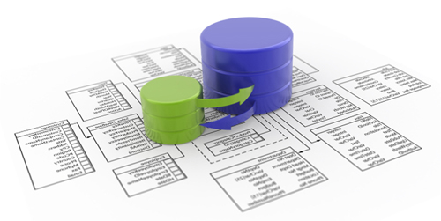
Establishing Water Information System (WIS)
Indicator 8: WIS databases (tabular and geospatial data)
Deadline: May 2019
Responsible: WIS Coordinator and WIS team
Status : According to target ☑.
Action :
Inventory of tabular and geospatial data and assessment of the needs of potential users of WIS and partners until May 2018 ☑.
Design of the database / creation / implementation of MEWR and ALRI until February 2019 ☑.
Development of the DBMS and the National Geo Data Base of the WRIC/MEWR until May 2019 ☑.

Slide 19
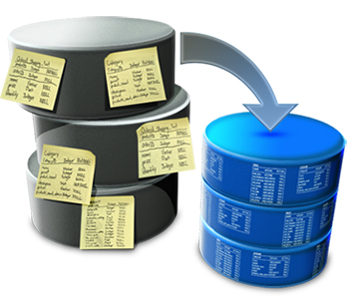
Establishing Water Information System (WIS)
Indicator 9: Exchange of available water data collected by WRIC/MEWR in the DIN, Portal
Deadline: December 2019
Responsible: WIS Coordinator and WIS team
Status : According to target ☑.
Action :
The exchange of available water data collected by the WRIC/MEWR via DIN - (1) define or identification of data before May 2019, ☒ preparation and design of the database until July 2019 ☒, and input all data at the end of 2019.

Slide 20
Establishing Water Information System (WIS)
Indicator 10: Creation of the WIS Portal
Deadline: June 2019
Responsible: WIS Coordinator and WIS team
Status: According to target ☑.
Action:
www.wis.tj
Development of the concept for the creation of the WIS web site until September 2018 ☑,
Development of design and implementation of the WIS Portal until May 2019 ☒, and input at the end of 2019.

Slide 21
Establishing Water Information System (WIS)
Indicator 11: Development of three on-line databases
Deadline: May 2019
Responsible: WIS Coordinator and WIS team
Status: According to target ☑.
Action:
Application IMIS – ToR May 2018 ☑, Announce tender August 2018 ☒, Development February 2019 ☒ and testing and training until May 2019 ☒
Applicaton BPD – ToR May 2018 ☑, Announce tender August 2018 ☒, Development February 2019 ☒ and testing and training until May 2019 ☒
Application BWAD– ToR May 2018 ☑, Announce tender August 2018 ☒, Development February 2019 ☒ and testing and training until May 2019 ☒

Slide 22
Establishing Water Information System (WIS)
Indicator 12: Capacity building
Deadline: July 2019
Responsible: WIS Coordinator and WIS team
Status: According to target ☑.
Action:
Basic computer training for staff MEWR and ALRI until July 2018 ☑, Office of ALRI and RBO/Kofarnihon until September 2018 ☑, BWOK until December 2018 ☑.
Advanced computer training for staff MEWR and ALRI until January 2019 ☑, Office of ALRI and RBO/Kofarnihon until February 2019 ☑, BWOK until April 2019 ☑.
Special training sessions on collecting and analyzing relevant data of MEWR, ALRI, CEP, Hydromet, Geology until February 2019 ☑, Office of ALRI and RBO/Kofarnihon until July 2019 ☑, BWOK until May 2019 ☑.

Slide 23
Ба диккататон ташаккур!
Thanks for your attention!
Чон рахмат!

